Slide 1
Discourse Analysis
Week 3

Slide 2
How to grasp meaning(s)?
By recognizing the form
By recognizing the function
By identifying context in-use

Slide 3
Typology of Pragmatic / Discourse meaning
Form -- Function
Function – Form

Slide 4
Sentence types
Declarative sentence
Interrogative sentence
Imperative sentence
Acts types
Command
Prohibition
Request
Questions

Slide 5
Two strangers in bus stop in an icy wind
A : “My goodness, it’s cold”
B: “Yes you are right”
“It could even worse”

Slide 6
Function of Language
Transactional
Interactional

Slide 7
Cohesion
Exophoric : interpretation lies outside the text
Look at that!
Endophoric : interpretation lies within the text
a) Anaphoric : look backward
Look at the sun, it is going to down quickly.
B) Cataphoric : look forward
It is going down quickly, the sun.

Slide 8
Context
Situational context
Background knowledge context
Context of text

Slide 9
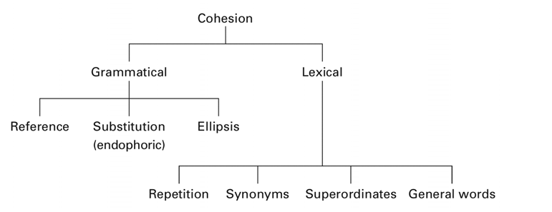
Cohesion

Slide 10
Brown and Yule. 1993. Chapter 3
Cutting. 2008. Chapter 1

Slide 11
Deixis
Person
Place
Time
http://linguistics.oxfordre.com/view/10.1093/acrefore/9780199384655.001.0001/acrefore-9780199384655-e-213
https://www.thoughtco.com/deictic-expression-deixis-1690428

Slide 12
A:Oh, there’s that guy again (pointing)
B:Oh yeah, now I see him (fixing gaze on the guy)
In an exchange above, A’s utterance spotlights the individual guy, directing B’s attention to him, and B’s response (both verbal and ocular) displays that he has recognized him.

Slide 13
A:I’ll have that one over there (pointing to a dessert on a tray)
B:This? (touching pastry with tongs)
A: Yeah, that looks great
B:Here ya’ go (handing pastry to customer)
A’s utterance individuates one pastry among several, B’s response makes sure he’s attending to the right one, A reconfirms and B completes by presenting the pastry to him

Slide 14
Topics in Discourse Analysis
Language and society
Language and identity
Language and politics
Language and ideology
Language and power

Slide 15
Theories in Discourse Analysis
Systemic functional linguistics
Conversation analysis
Modality
Actor representation
Nominalization, passivation
Corpus linguisitcs

Slide 16
Social theories
Power and domination
Feminism
Ideology
Hegemony
Prejudice

Slide 17
To do in February 19th
Review the paper
“HEGEMONIC AND MINORITY DISCOURSES AROUND IMMIGRANTS: A CORPUS-BASED CRITICAL DISCOURSE ANALYSIS”
Download in from UIN Repository
Menu search: author : Irham : Teaching recourse

