Slide 1

Menulis Artikel untuk Jurnal Bereputasi
Mundi Rahayu
UIN Maulana Malik Ibrahim Malang
mundi@bsi.uin-malang.ac.id
Workshop ALTI, 2 Maret 2021

Slide 3
How to Start
Choose a research topic
Narrowing the topic
Trace the previous published researches

Slide 4
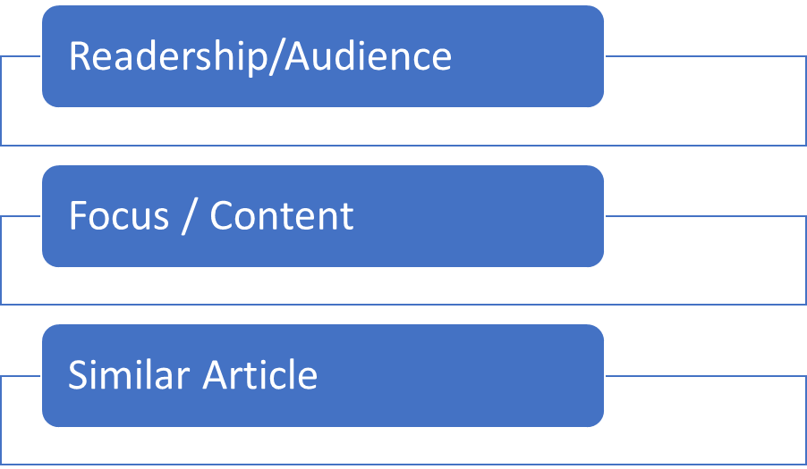
Know the Journal

Slide 5
Jenis Artikel
1. Research article : +/- 6,000 words
2. Short reports or letters or brief communications (brief reports of data from original research that will likely stimulate further research in the field)
3. Review articles: (a comprehensive and critical summary of research on a certain topic written by leaders in a particular discipline) 8,000 – 40,000 words
4. Case studies (specific instances of interesting phenomena)
5. Methodologies or method (a new experimental method, test or procedure)
6. Commentary (essays that present a personal point of view critiquing widespread notions) +/-2,000 words
7. Book review

Slide 6
Naskah Jurnal
Title
Author’s name and affiliation
Abstract
Body
References
Footnotes
Appendices
Supplemental materials
Body of Manuscript: (IMRAD)
Introduction
Method
Results
Discussion
Implication/recommendation
Conclusion

Slide 7
Title
Concise, accurate and informative
Titles are often used by search engines so that title needs to be specific
reflect content
Journal’s scope

Slide 8
Abstract
Approximately 100-250 words
Must be accurate as a reflection of what is in your article
Must be self-contained, without abbreviations, footnotes, or incomplete references
Key words at end
Method
Purpose
Key results
Implication

Slide 9
Introduction
Structure:
Specific problems – engaging the readers
Review of related literature
Relevant implication
Key variables

Slide 10
Literature Review
The current state of the literature (the last 5 years)
Need to demonstrate the relevance
Keep up to date
Engage with material

Slide 11
Method
As complete as possible
Engage with material

Slide 12
Result and Discussion
Result:
Data 1
Data 2
Data 3
Discussion:
Analisis
Finding pattern
Comparison contrast
Interpretation

Slide 14
Content Check List
Is your article:
Well sequenced?
Analytically adequate?
Theoretically adequate?
Stylistically adequate?
Original/not published elsewhere?
Proof read

Slide 15
Some Other Check List
Does the introduction state the contribution the article is making?
Does the article have appeal to the readership?
Does the article justify the findings and why they matter and for whom?
Does the article present new information?
Does the conclusion restate and reinforce what is being said?

Slide 16
Thank You
شكرا

