Slide 1
DEVELOPING LITERACY-BASED ENGLISH TEACHING
DR. MUNDI RAHAYU, M.HUM
mundi@bsi.uin-malang.ac.id
082336541811

Slide 2
Overview
LITERACY IN DIGITAL ERA
LITERACY
SHIFTS IN DIGITAL ERA
LITERACY FOR CHILDREN
CHARACTERISTICS
LITERACY-BASED ENGLISH TEACHING

Slide 3
LITERACY IN SHIFT
OLD
able to read and
Able to write
respond texts for comprehension
NOW
read the words for the world (Freire)
To understand text critically, to be skeptical of the hidden agenda behind the texts. To read between the lines.
To be able to take a position towards texts (to accept, to accept with notes, to reject with notes, to totally reject, to trash)

Slide 4
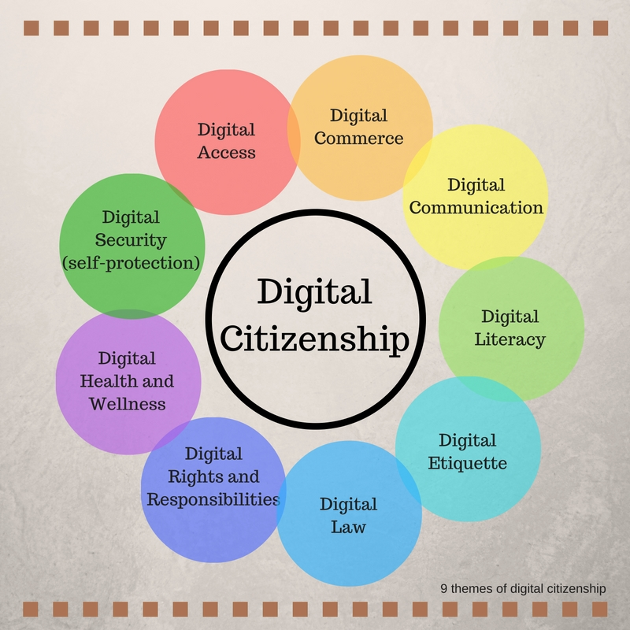
LITERACY IN DIGITAL ERA

Slide 5
Foundational Literacies
2
4
Numeracy and Scientific
ICT
1
3
5
Literacy
Financial
Cultural and Civic Literacy

Slide 6
CRITICAL THINKING / PROBLEM SOLVING
COMMUNICATION
COMPETENCIES
CREATIVITY
COLLABORATION

Slide 7
CHARACTER QUALITIES
SOCIAL AND CULTURAL AWARENESS
CURIOSITY
1
6
LEADERSHIP
INNNITIATIVE
2
5
3
4
ADAPTABILITY
PERSISTENCE

Slide 8
Four Resource Model
Code Breaker
How do I read /understand the code /text
Text Participant
How do I participate/draw meaning from the text?
Text User
Who is the reader? What is the purpose of the text? What is My Purpose? Who is the audience for my text?
Text Analyst
How does the text influence me?
How does the text position me?
How does the text position others?

Slide 9
Children literacy
experience, values of life in various genre
Rich with human issues to discuss, critique and make dialogue
pleasure, enjoyment
Open multi interpretation and reading position

Slide 10
The Very Hungry Caterpillar - Animated Film
https://youtu.be/75NQK-Sm1YY

Slide 11
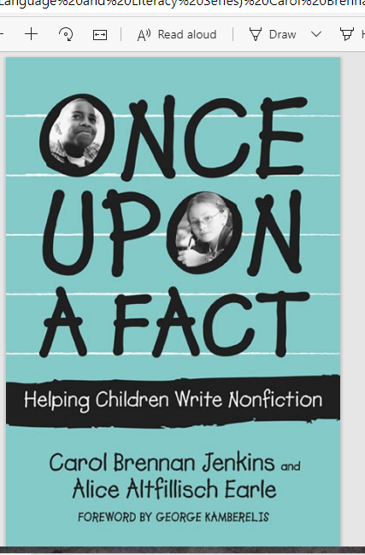

Slide 13
